Slide 1
This presentation runs on its own.
No user intervention is needed.

Slide 2
This presentation is designed to inspire the direction of major
Internal Research Funding
to seed a
Bold New Mission for LANL

Slide 3
Created by
Scott R. Runnels, Ph.D.
Randy Bos, Ph.D.
Los Alamos National Laboratory

Slide 5
The average American believes there is no use in planning cities to resist a nuclear attack.

Slide 6
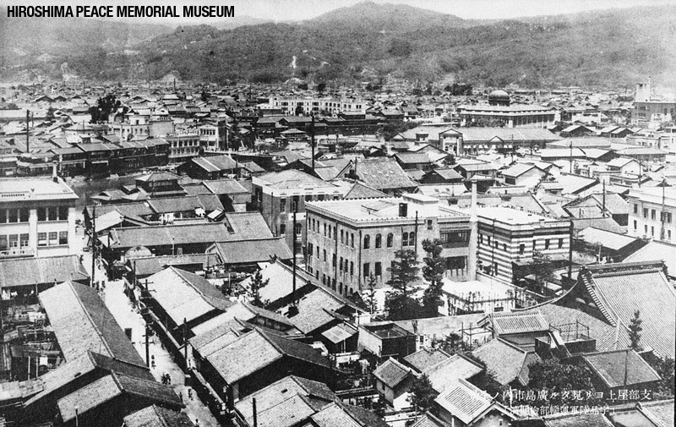
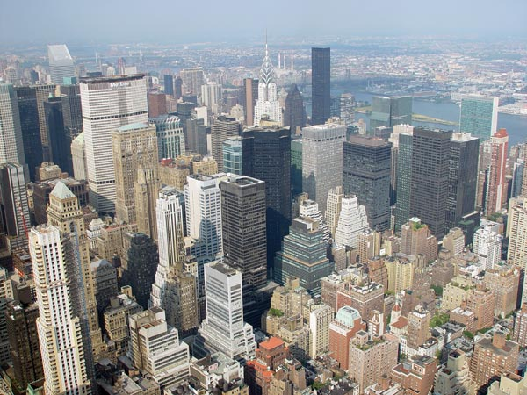
But this:
is not the same as this:
Hiroshima, before the atomic bomb
Midtown Manhattan

Slide 7
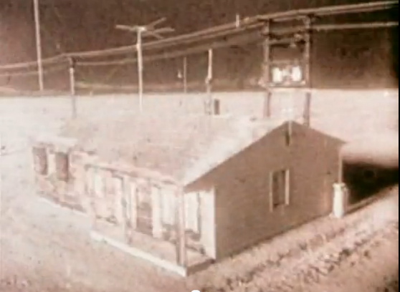
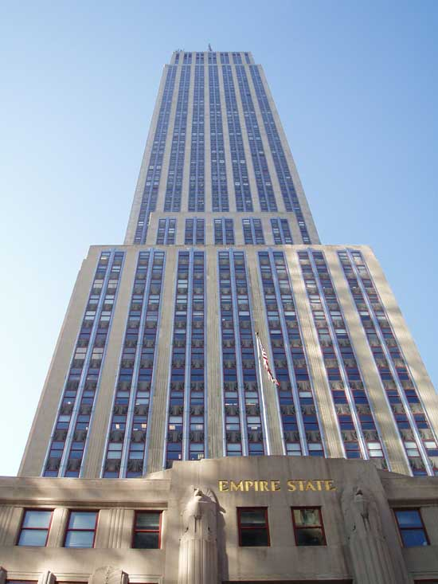
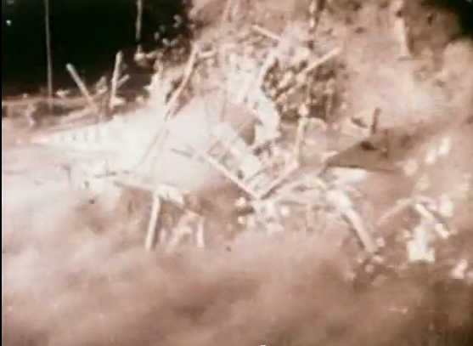
And this:
is not the same as this:

Slide 8
Contrary to what the public thinks, a nuclear attack can be managed to reduce casualties.
But LANL’s passiveness has implied that there is no hope.

Slide 9
If only the public knew, they would urge us to begin…

Slide 10
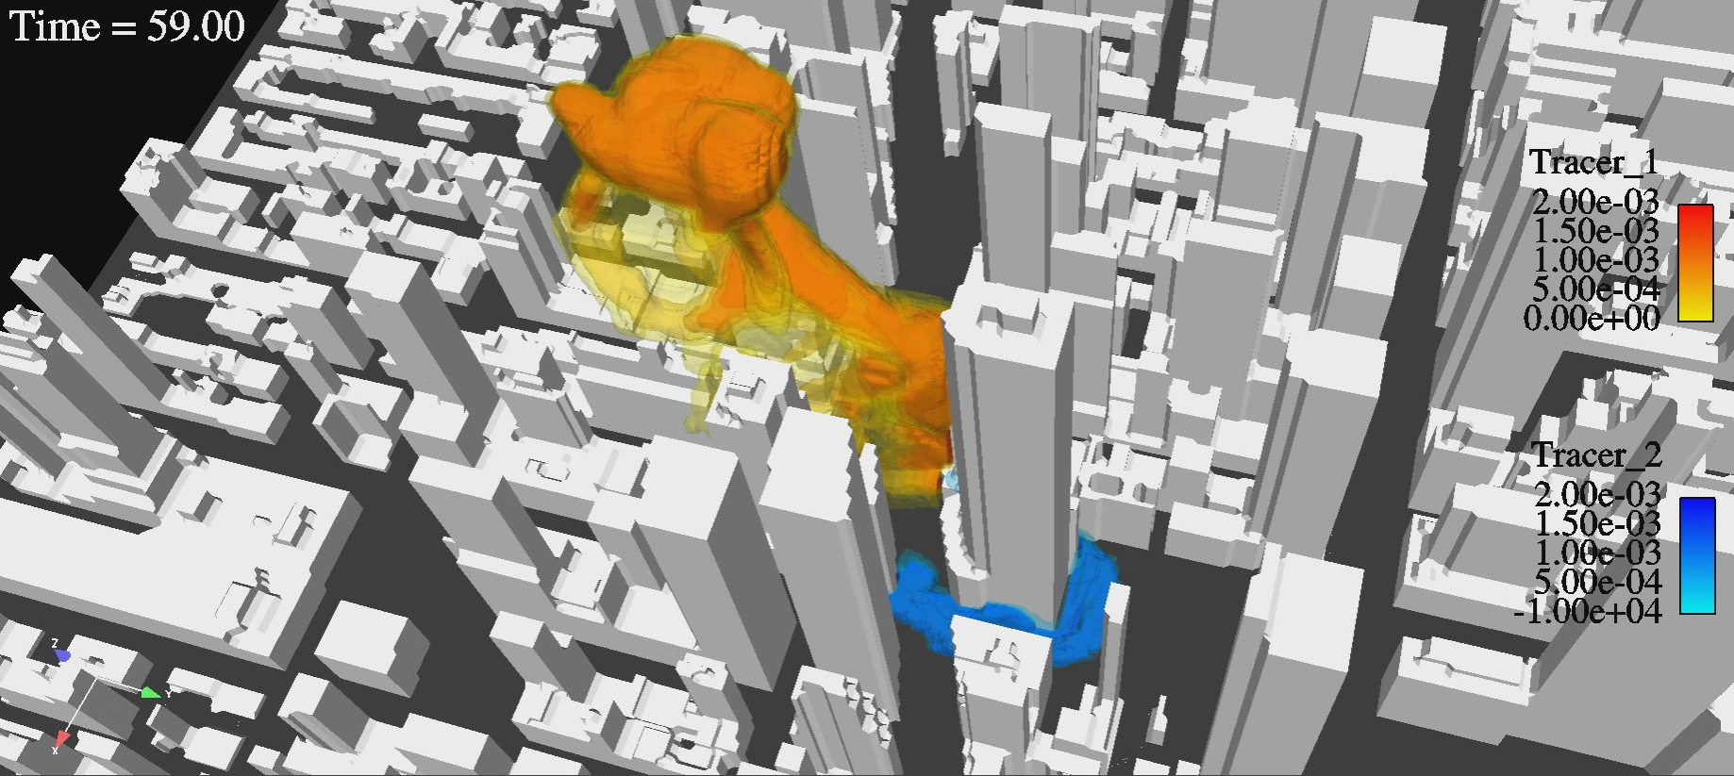
Using Computer Simulation to Plan
The
Nuke-Resistant City
Los Alamos National Laboratory
“The World’s Greatest Science Protecting America”

Slide 11
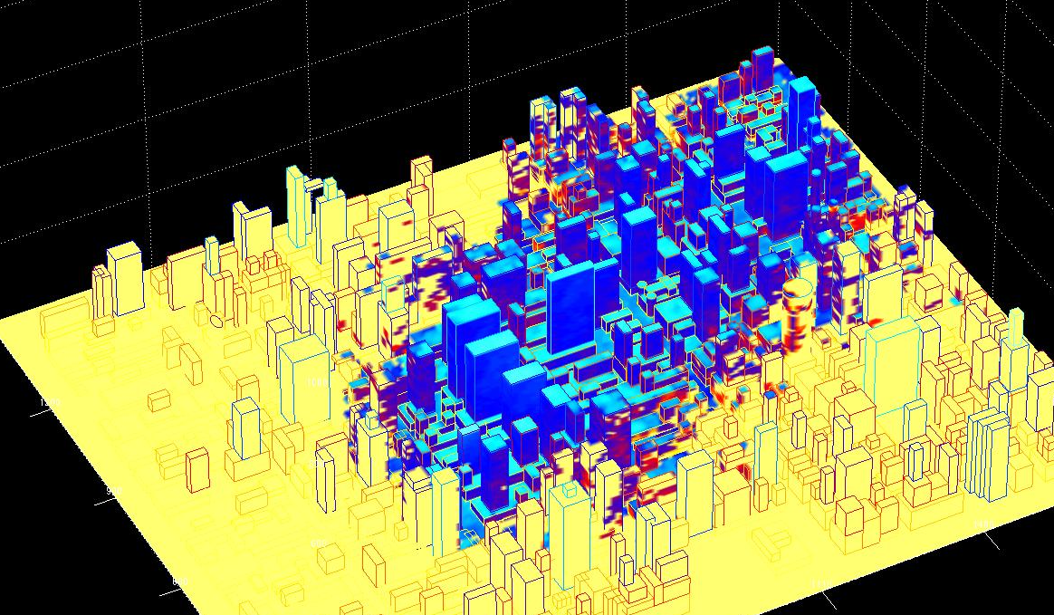
Seldom does science play a role of such importance and urgency.
Scientists are accustomed to thinking their work is important, but never this urgent.

Slide 12
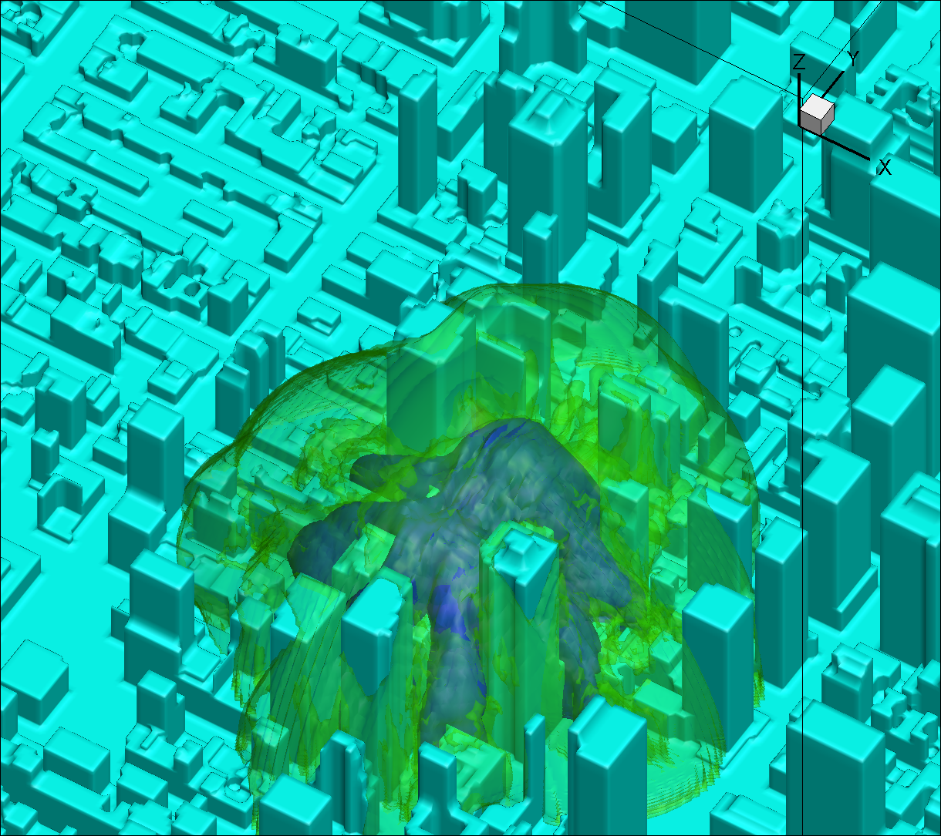
The last time importance and urgency descended simultaneously in this way on science was the Manhattan Project.
It has descended again.

Slide 13
The time is now to focus efforts on helping cities prepare. And, in so doing…

Slide 14
Save lives
Advance scientific understanding
Secure the role of LANL and science in the US for the next 50 years

Slide 15
The Less Powerful Fission Bomb
of Hiroshima and Nagasaki
The massively destructive
Thermonuclear Bomb
of the Cold War
The policy of
Mutually Assured Destruction
which kept the Cold War cold.
The strong possibility of a
Terrorist/Rogue Attack

Slide 16
The Less Powerful Fission Bomb
Thermonuclear Bomb
In the mind of the average American, these issues are confused and mixed with disturbing images, resulting in
Mutually Assured Destruction
Terrorist/Rogue Attack

Slide 17
The Less Powerful Fission Bomb
Thermonuclear Bomb
Mutually Assured Destruction
DENIAL
Terrorist/Rogue Attack

Slide 18
The Less Powerful Fission Bomb
Thermonuclear Bomb
Mutually Assured Destruction
Unnecessary
Fear
Terrorist/Rogue Attack

Slide 19
The Less Powerful Fission Bomb
Thermonuclear Bomb
Mutually Assured Destruction
POOR
PLANNING
Terrorist/Rogue Attack

Slide 20
The Less Powerful Fission Bomb
Thermonuclear Bomb
Mutually Assured Destruction
It is our responsibility to tell the people that…
Terrorist/Rogue Attack

Slide 21
The Less Powerful Fission Bomb
in a
Thermonuclear Bomb
…is manageable.
Mutually Assured Destruction
It is our responsibility to tell the people that…
There is hope.
Our new threat…
Terrorist/Rogue Attack
But we must prepare.

Slide 22



We must tell the people that
May actually be survived by people here.
An improvised nuclear weapon detonated here:

Slide 23
We must tell the people that
The Threat We Actually Face
can be managed to greatly reduce casualties

Slide 24
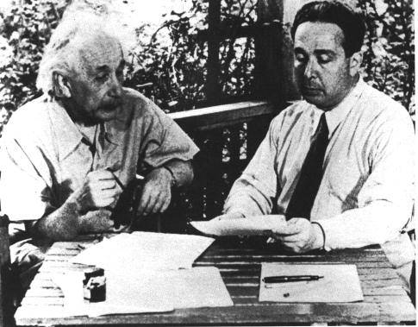
Scientists have swayed the government before.
Einstein and Szilard

Slide 25
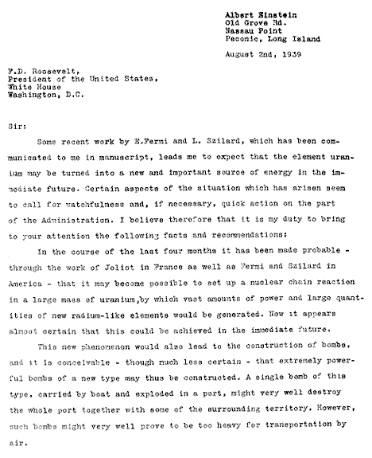

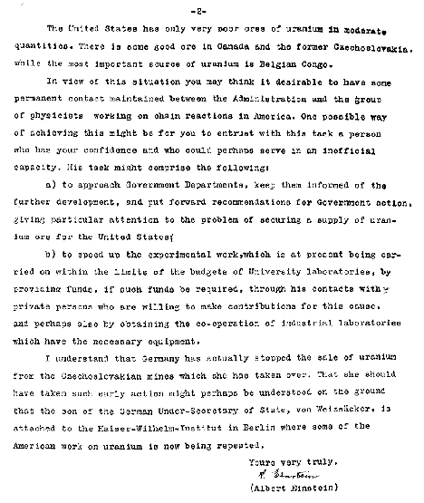

Scientists have swayed the government before.
It took
a great name
and initiative
to get the government’s attention.

Slide 26
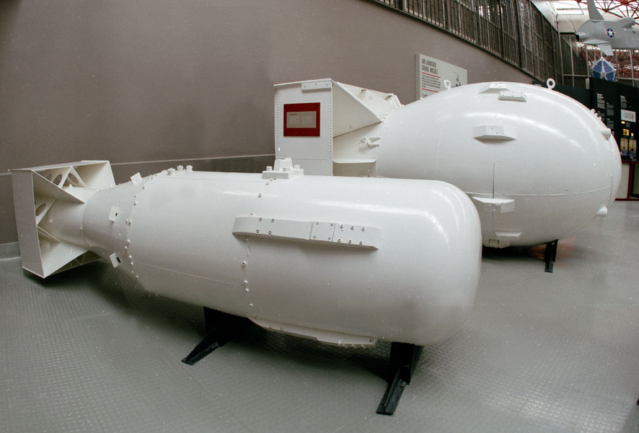
It took
We
have
the name.
a great name
and initiative
to get the government’s attention.
We must
take
the initiative.

Slide 27
And so, this message will hopefully do more than inspire the use of internal research and development funding at LANL.

Slide 28
It will hopefully…
Inspire LANL staff to become involved in this bold new mission.
Lead to technical work that helps the government fund these life-saving measures.

Slide 30
What we Propose
Use LANL
Internal Research and Development funding
to create information and technology
that demonstrates to the government there is hope
and that more needs to be done.

Slide 31
The
information and technology
will emerge from a
Computational and Experimental Program
that will eventually grow under government funding.

Slide 32
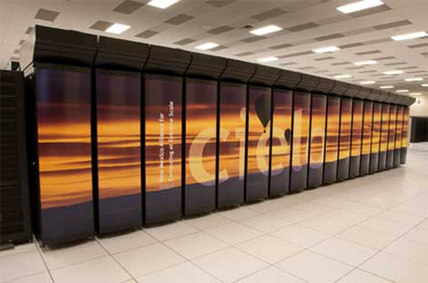
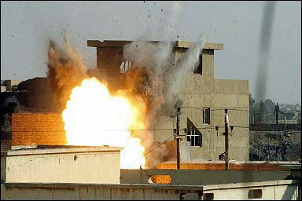
We will Deliver
Models will provide predictions of all the consequences of a nuclear attack for any point in any major US city.
High-Fidelity Integrated Models
Massive integrated computations
Physics
Sub-Models
Human Effects
Models
Validated by massive experimental program
Experimental Data
Experimental Data

Slide 33
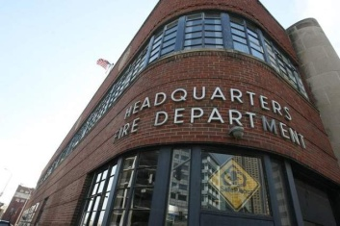
The high-fidelity models will be used in advance to validate simpler fast-running models for use on the scene.
Laptop Nuclear Effects Advising Software
Run on the scene
High-Fidelity Integrated Models
Massive integrated computations
Physics
Sub-Models
Human Effects
Models
Validated by massive experimental program
Experimental Data
Experimental Data

Slide 34
It will answer
Laptop Nuclear Effects Advising Software
Run on the scene
High-Fidelity Integrated Models
Massive integrated computations
Physics
Sub-Models
Human Effects
Models
Validated by massive experimental program
Experimental Data
Experimental Data

Slide 35
Who is still alive?
Who should move, who should shelter in place?
How are the utilities and subways?
What’s next?
LANL-Communication system will provide real-time updates to adjust models.
Laptop Nuclear Effects Advising Software
Run on the scene
High-Fidelity Integrated Models
Massive integrated computations
Physics
Sub-Models
Human Effects
Models
Validated by massive experimental program
Experimental Data
Experimental Data

Slide 36
Who is still alive?
Who should move, who should shelter in place?
How are the utilities and subways?
What’s next?
LANL
Com. System
Laptop Nuclear Effects Advising Software
Run on the scene
Real-time data updates model
High-Fidelity Integrated Models
Massive integrated computations
Physics
Sub-Models
Human Effects
Models
Validated by massive experimental program
Experimental Data
Experimental Data

Slide 37
The high-fidelity models will also help cities plan in advance.
High-Fidelity Integrated Models
Massive integrated computations
Physics
Sub-Models
Human Effects
Models
Validated by massive experimental program
Experimental Data
Experimental Data

Slide 38
How many first responders might we need?
What should we train them to do?
What special equipment will they need?
What building codes need to change?
Comprehensive Planning Document
High-Fidelity Integrated Models
Massive integrated computations
Physics
Sub-Models
Human Effects
Models
Validated by massive experimental program
Experimental Data
Experimental Data

Slide 39
This endeavor will save lives through the application of
Broad Scientific Disciplines
in a tightly integrated effort.

Slide 40
How many first responders might we need?
What should we train them to do?
What special equipment will they need?
What building codes need to change?
Comprehensive Planning Document
High-Fidelity Integrated Models
Massive integrated computations
Physics
Sub-Models
Human Effects
Models
Validated by massive experimental program
Experimental Data
Experimental Data

Slide 41
High-Fidelity Integrated Models
Physics
Sub-Models
Human Effects
Models
Experimental Data
Experimental Data

Slide 42
Physics
Sub-Models
Modeling the impact of a nuclear detonation on a city is a daunting challenge.
But it is doable.

Slide 43
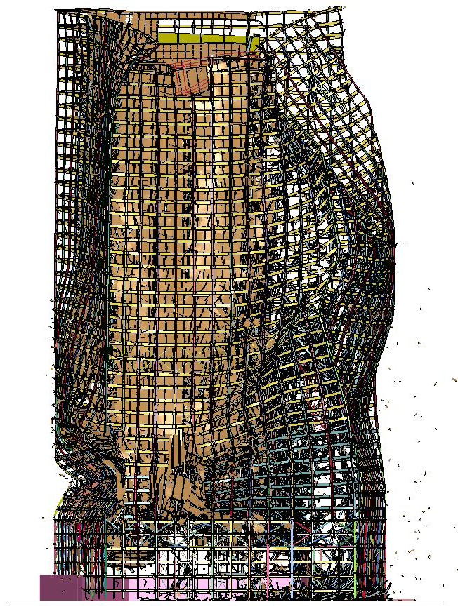
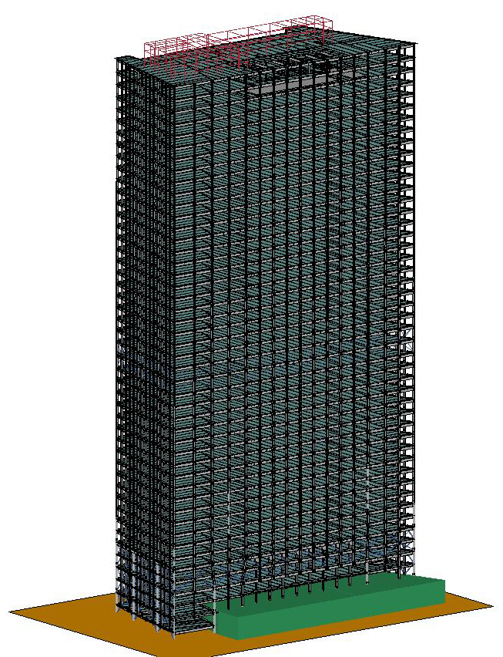
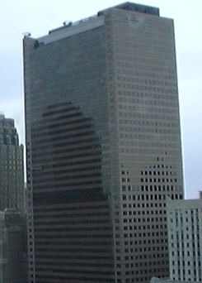
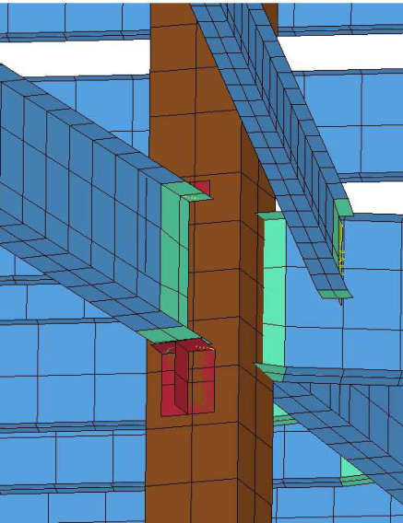
Physics
Sub-Models
Model formed by ARA
We can form highly detailed models for individual buildings…
World Trade Center Building WTC7
911 Collapse as viewed from the South

Slide 44




Physics
Sub-Models
And we can even model multiple types of buildings…
We know how to model physics such as blast waves and nuclear radiation…

Slide 45
Physics
Sub-Models
But we cannot do that for every building...

Slide 46
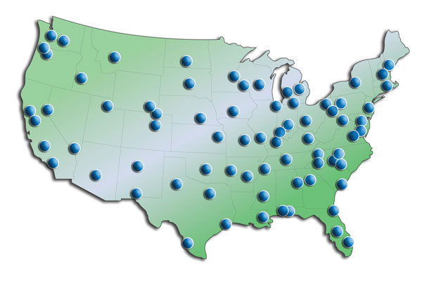
Physics
Sub-Models
In every city…

Slide 47
Physics
Sub-Models
We must think about modeling in new ways.
We must combine multiple geometric scales, forming new kinds of simple models for buildings.

Slide 48
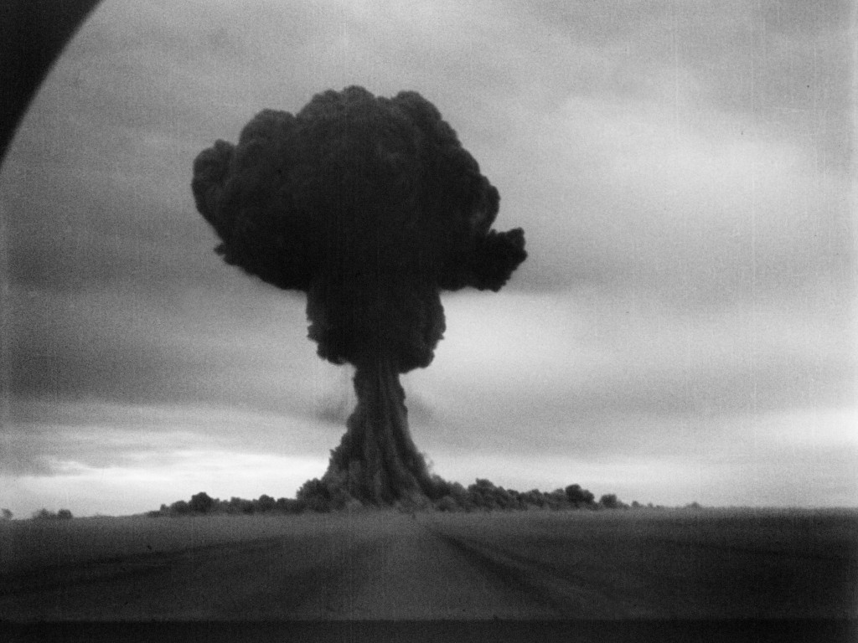
Physics
Sub-Models
We must model the fireball
and the electromagnetic pulse

Slide 49
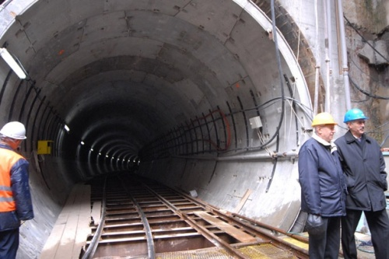
Physics
Sub-Models
And the impact on subways and underground utilities.

Slide 50
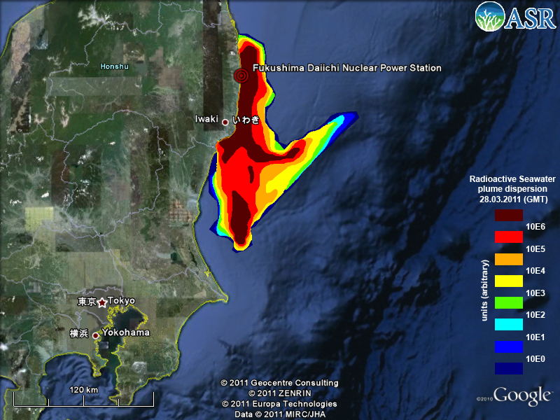
Physics
Sub-Models
As well as radiation contamination transport through the atmosphere

Slide 51
Physics
Sub-Models
These models will need massive computational and experimental efforts that will challenge multiple scientific areas.

Slide 52
And we will have to model…

Slide 53

People
The people who are paying us and trusting us to do the right thing.

Slide 54
Physics
Sub-Models
Sensor & Com. System
Experimental Data
Human Effects Models
Uniting LANL Behind a Bold New Mission
Helping to transform our funding agencies
Providing technical leadership for the United States and the world

Slide 55
Physics
Sub-Models
Sensor & Com. System
Experimental Data
Human Effects Models
Uniting LANL Behind a Bold New Mission
Helping to transform our funding agencies
Providing technical leadership for the United States and the world

Slide 56
This will not be easy:
Helping to transform our funding agencies

Slide 57
We must integrate our technologies into tangible products (deployable software and real-time communication system).
LANL
Com. System
Laptop Nuclear Effects Advising Software
Run on the scene
Real-time data updates model
High-Fidelity Integrated Models
Massive integrated computations

Slide 58
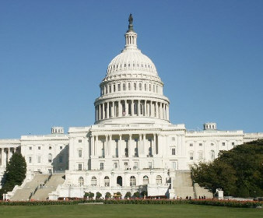
We must combine our efforts with ongoing and organized promotional activities in Washington.
3 Years of LANL investment
Federal funding ramps up
Ongoing reporting and promotional activities in D.C.
Time

Slide 59
3 Years of LANL investment
This will be our Einstein Letter.

Slide 60
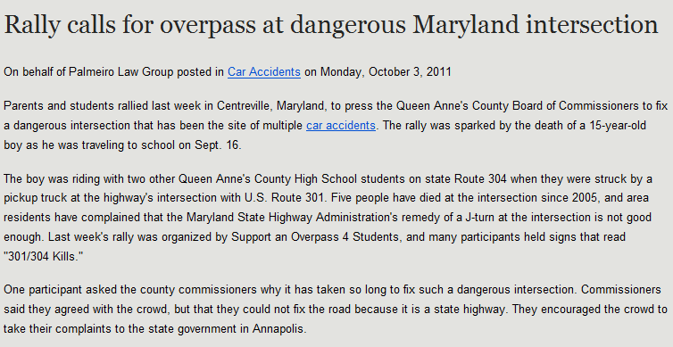

America has a
reactive culture.

Slide 61
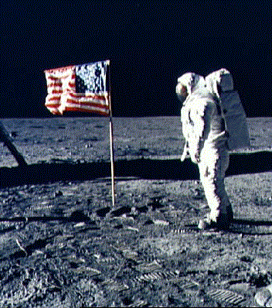
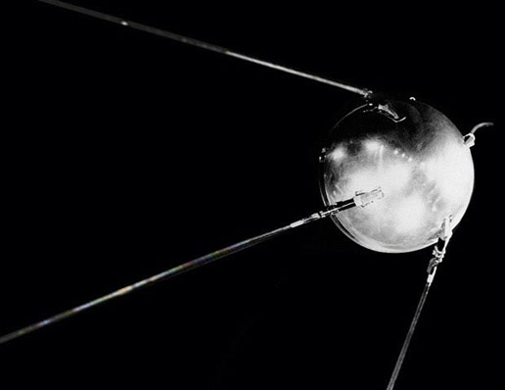
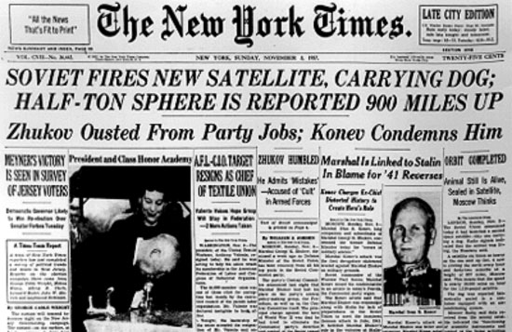
America has a
reactive culture.
And can react well when prompted.

Slide 62
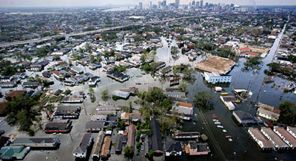
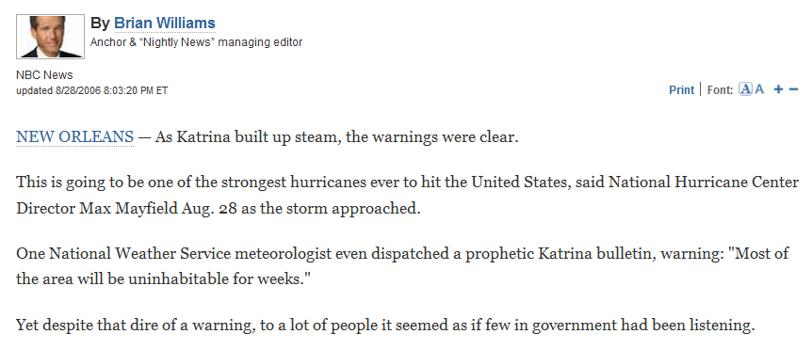
But the public prompt isn’t always heard.

Slide 63
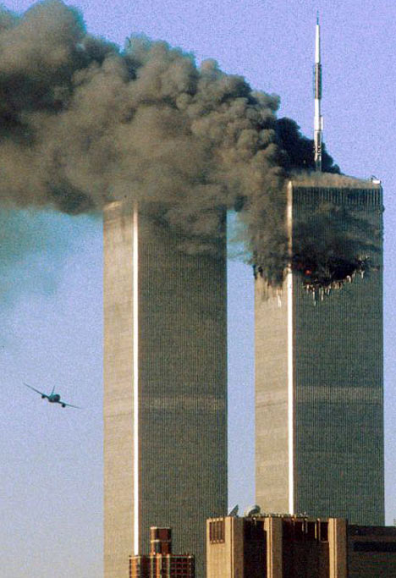
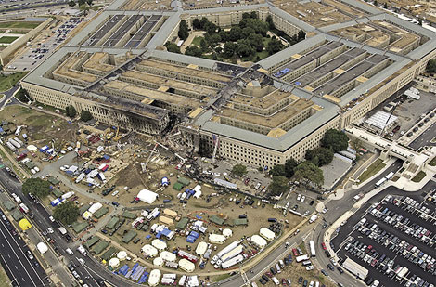
And there isn’t always a gentle learning curve…
There were four airplanes that day.

Slide 64
Seldom and powerful are the moments when science prompts a proactive response.
It is time to do so now.

Slide 66
Of what value is science if it does not rise to this challenge?

Slide 68
The American people have preserved our capabilities for a time such as this.
Now we must deliver.

